Slide 1

A Framework for Quality assessment of LOD for Potential Dual use
Semantic Web Lab Project, University of Bonn, Germany
Department of Computer Science
2016

Slide 2
Designed, Implemented and Tested By
Ali Denno
Amal Amouri
Mohammad Denno
Ola Al-Nameh

Slide 3
Prof. Dr. Sören Auer
Professor at university of Bonn
Bonn, Germany
Prof. Maria Esther Vidal
Researcher at University of Bonn
Harsh Thakkar
Researcher at University of Bonn

Slide 4
Content
Motivation
LOD system structure
Work Flow
Results and performance
Techniques used in the project
Challenges

Slide 5
Start

Slide 6

Motivation

Slide 7
“You always have the problem of dual-use in every new technology. Steel can be used to make swing needles or spears.”
Lauri Zoloth!

Slide 8
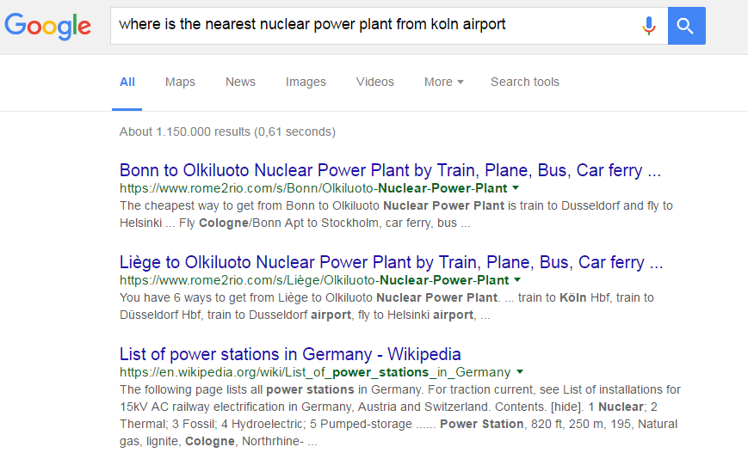

Slide 9
Notes:
The question is malicious but using an intelligent question answering system could retrieve malicious answer

Slide 10
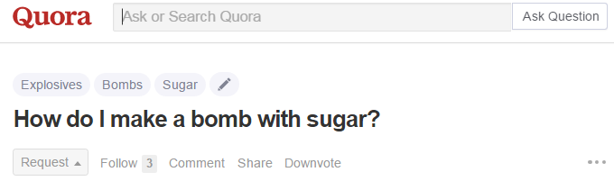
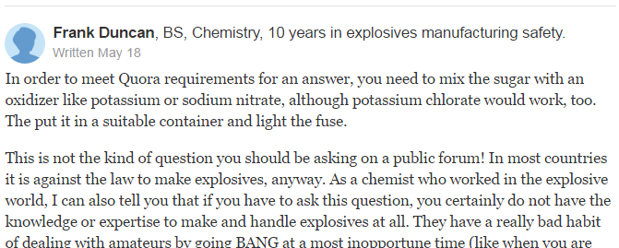
Notes:
How can I make a bobmb using home items from qura

Slide 11
Warning !!
Notes:
How can I make a bobmb using home items from qura

Slide 12

System Structure

Slide 13
The Whole Picture
Heterogeneous data sources
Natural language question
Answer presentation module
Preprocessing & fixing text
Potential Dual Use Assessment system
Entity & POS tagging
Free Base
DBpedia
Searching answer candidate & indexing
Question classification
Generating answer template
Wikidata
Xml, etc
Question representation
Notes:
Where we fit in this project(where is our work in this story)

Slide 14
Potential Dual Use Assessment System
Malicious intent System
Question Analysis
Answer Analysis
Profiling System
Notes:
The dual use system will receive the queries from QA system and use the profiles to rank the queries and take the suitable action

Slide 15
Profiling System
Defining malicious categories
Categories
Notes:
starting with the profiling system
First we will define main malicious catogries and fill them in a hash map

Slide 16
Profiling System
Defining malicious categories
Categories
uClassify api
&
Snowball stemmer
Finding synonyms, Roots & Rank
Malicious word
Notes:
Then we will search in dictionaries for synonyms to extract our categories and rank them with uClassify api for sentiment analysis

Slide 17
Profiling System
Defining malicious categories
Categories
Finding synonyms, Roots & Rank
Malicious word
Querying Synonyms
Resources
Notes:
The malicious words we gathered will be queried using Sparql to get related resources from Dbpedia and wikidata

Slide 18
Profiling System
Defining malicious categories
Categories
Finding synonyms, Roots & Rank
Malicious word
Querying Synonyms
Resources
Filing categories
Profiles
(SQL DB)
Notes:
These resources will be used to fill our categories and as a result we will have our malicious profiles.

Slide 19
Potential Dual Use Assessment System
Malicious intent System
Question Analysis
Answer Analysis
Profiling System

Slide 20
Malicious intent System
Question Analysis
Thresholding
Neural Network

Slide 21
Question Analysis
Thresholding
Receive question
Forwarded query
Tokenize question
Tokens
Querying tokens
Profiles
(SQL DB)
Threshold > 0.5
Rank the question

Slide 22
Something new, fresh, interesting in the air..

Slide 23

Convolutional NN

Slide 24

An Idea..
Notes:
We used the idea in the CNN paper to classify our questions to malicious or not

Slide 25
The Plan
CNN
FNN
Convolutional Neural Network
Feed Forward Neural Network

Slide 26
Phase 1
How
to
make
a
bomb
Representation of sentence

Slide 27
Phase 1
Convolution network
How
to
make
a
bomb
Representation of sentence

Slide 28
Phase 1
Convolution network
How
to
make
a
bomb
Max of each Filter
Representation of sentence

Slide 29
Phase 2
Input Features

Slide 30
Phase 2
Feed Forward network
…
Prediction of malicious
classification
…
Input Features

Slide 31

Input Representation
Notes:
The most important thing in neural networks is to the input representation

Slide 32


Input Representation
Safe
Malicious

Slide 33
Input Representation
1- How to kill an insect?
2- What is the killing joke?
3- What bombs are made of?
4- What is nuclear energy?
.
.
.
1- How to kill a person?
2- What is the way to kill?
3- How to build a bomb?
4- What is the closest nuclear reactor?
.
.
.

Slide 34
Extracting Features Process
300 Extracted Features
Input the sentence
Tokenize the words
Encoding

Slide 35
Extracting Features Process
300 Extracted Features
Input the sentence
Tokenize the words
Encoding

Slide 36
Extracting Features Process
300 Extracted Features
Input the sentence
Tokenize the words
Encoding

Slide 37
Extracting Features Process
300 Extracted Features
Input the sentence
Tokenize the words
Encoding

Slide 38
Extracting Features Process
300 Features
word 1
word 2
word 3
…
…
Input the sentence
…
Tokenize the words
Encoding
…
…
…

Slide 39

CNN Analysis

Slide 40
Accuracy
0
24%
Not Right!
76%
Just Right

Slide 41
Potential Dual Use Assessment System
Malicious intent System
Question Analysis
Answer Analysis
Profiling System

Slide 42
Malicious intent System
Answer Analysis
Dbpedia, WikiData
Quora
Notes:
The dual use system will receive the queries from QA system and use the profiles to rank the queries and take the suitable action

Slide 43
Malicious intent System
Dbpedia, WikiData
Fire SPARQL query against Dbpedia & WikiData
Answering resources
Comparing with malicious profiles
Rank
Take action
Notes:
The dual use system will receive the queries from QA system and use the profiles to rank the queries and take the suitable action

Slide 44
Malicious intent System
Answer Analysis
Dbpedia, WikiData
Quora
Notes:
The dual use system will receive the queries from QA system and use the profiles to rank the queries and take the suitable action

Slide 45

Using Quora

Slide 46
Dual Use System using Quora
Dual Use System
Quora
Query Quora
Pick 3 Quora Results
Count malicious words
Profiles
Mark as malicious link
Number of malicious words

Slide 47
Dual Use System using Quora
Dual Use System
Quora
Query Quora
Pick 3 Quora Results
Count malicious words
Profiles
Mark as malicious link
Number of malicious words

Slide 48
Dual Use System using Quora
Dual Use System
Quora
Query Quora
Pick 3 Quora Results
Count malicious words
Profiles
Mark as malicious link
Number of malicious words

Slide 49
Dual Use System using Quora
Dual Use System
Quora
Query Quora
Pick 3 Quora Results
Count malicious words
Profiles
Mark as malicious link
Number of malicious words

Slide 50
Dual Use System using Quora
Dual Use System
Quora
Query Quora
Pick 3 Quora Results
Count malicious words
Profiles
Mark as malicious link
Number of malicious words

Slide 51
Work Flow
Natural Language Question
NL Question to Sparql query framework
Question Analysis
Answer Analysis
Tokenization
Sparql query
Neural Network
Fire Query
Malicious or not
Quora Test
Dbpedia, Wikidata
Threshold Based Ranking
Malicious
Resources
Check profiles
Evaluate Resoures
Take Action & Report
Word Ranking
&
Resource Profiles

Slide 52

Testing & Comparison
Notes:
I think we should put the performance after the CNN section

Slide 53
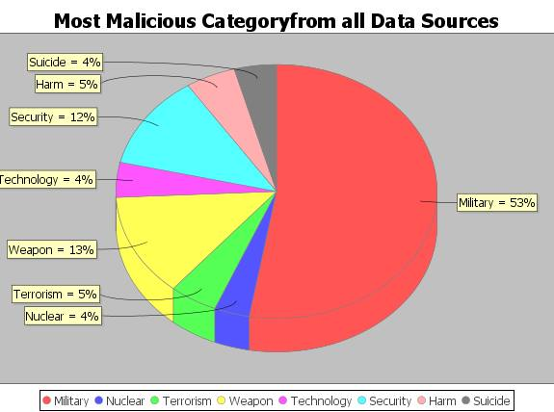

Slide 54
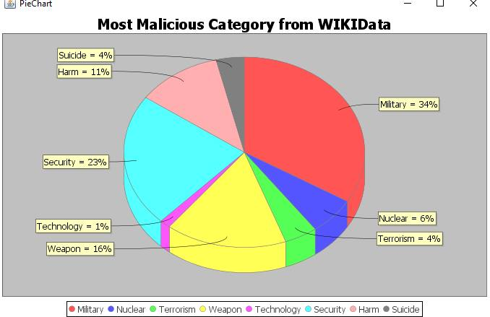
Notes:
WikiData

Slide 55
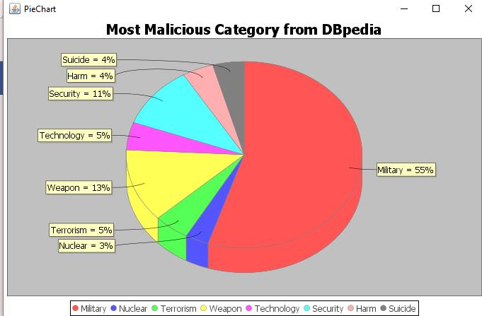

Slide 56

Techniques Used

Slide 57










Notes:
Add blocks which one in front end and which one is back end (I think it is useless there is only one front end tool we can just say that)

Slide 58
Backend
Notes:
Add blocks which one in front end and which one is back end (I think it is useless there is only one front end tool we can just say that)

Slide 59
DataBase
Backend
Notes:
Add blocks which one in front end and which one is back end (I think it is useless there is only one front end tool we can just say that)

Slide 60
Neural Network
Backend
Notes:
Add blocks which one in front end and which one is back end (I think it is useless there is only one front end tool we can just say that)

Slide 61
Quora
Backend
Notes:
Jsoup quora

Slide 62
Query Dbpedia & WikiData
Backend
Notes:
Wikipedia & wikidata

Slide 63
Words Roots
Backend
Notes:
Wikipedia & wikidata

Slide 64
Frontend
Notes:
Add blocks which one in front end and which one is back end (I think it is useless there is only one front end tool we can just say that)

Slide 65

Challenges
Notes:
Write about the challenges why we used quora and CNN

Slide 66
Challenges
Semantic of the sentence in the threshold-based approach
The content and information on DBpedia and Wikidata is not structured
Ranking of the words
Notes:
1- Semantic of the sentence in the threshold-based approach. Basically when using this approach, the question is tokenized and then fired against the database and against the profiles we have in there, therefore sentences such as: How to kill a person VS. How to kill an insect, usually result in the same danger level although the first one is more dangerous. That’s why we made use of neural networks which are able to learn in a supervised way and then improve and eventually realize the semantic difference between these two.
2- The content and information on DBpedia and Wikidata is not structured well and also these two datasets don’t really contain much controversial topics and categories, therefore we had to implement tests on Qoura in order to validate the task of our system, as it was hard to do that on the previously mentioned datasets because of their limited content regarding malicious categories.
3- Ranking of the words:We first tried to use “SentiWordNet” to rank the words in the categories but the results were unaccurate so we resorted to using Uclassify api which gave much better results but not as satisfactory as we wished. As we wanted to rank according to how malicious it is but we didn’t find any tool to help us.

Slide 67
Live Demo!

Slide 68
Thank You!

